Slide 1
ADVANCED SQL
Database Concepts Spring 2021
Week 13
Notes:
Chapter 7

Slide 2
Structured Query Language (SQL)
Categories of SQL function
Data definition language (DDL)：Commands to create database objects such as tables, indexes, and views, as well as commands to define access rights to those database objects
Data manipulation language (DML):Commands to insert, update, delete, and retrieve data within the database tables

Slide 3
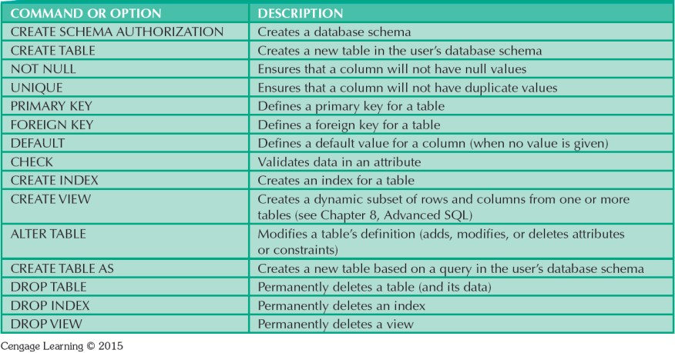
Table 7.1 - SQL Data Definition Command

Slide 4
Creating Table Structures in SQL
CREATE TABLE tablename (
column 1
column 2 PRIMARY KEY FOREIGN KEY
data type data type (column 1)
(column 2)
constraint, constraint,
REFERENCES tablename (column3)
CONSTRAINT
)
(constraint )
Notes:
Note that the CREATE TABLE command lets you define constraints in two different places:
• When you create the column definition (known as a column constraint).
• When you use the CONSTRAINT keyword (known as a table constraint).
A column constraint applies to just one column; a table constraint may apply to many columns.

Slide 5
Example 1:Creating Table Structures in SQL
CREATE TABLE vendor (
V_code INTEGER NOT NULL UNIQUE,
V_name VARCHAR(35) NOT NULL,
V_contact VARCHAR(25) NOT NULL,
V_areacode CHAR(3) NOT NULL,
V_phone CHAR(8) NOT NULL,
V_state CHAR(2) NOT NULL,
V_order CHAR(1) NOT NULL,
PRIMARY KEY (V_code))
engine=InnoDB;
Notes:
The primary key attributes contain both a NOT NULL and UNIQUE specification, which enforce the entity integrity requirements.
InnoDB is a storage engine for MySQL (MyISAM)

Slide 6
Example 2:Creating Table Structures in SQL
CREATE TABLE product (
P_code INTEGER NOT NULL UNIQUE,
P_descript VARCHAR(35) NOT NULL,
P_indate DATE NOT NULL,
P_qoh SMALLINT NOT NULL,
P_min SMALLINT NOT NULL,
P_price DECIMAL(8,2) NOT NULL,
P_discount DECIMAL(5,2) NOT NULL,
V_code INTEGER,
PRIMARY KEY (P_code),
FOREIGN KEY (V_code) REFERENCES vendor(V_code)
ON UPDATE CASCADE)
engine=InnoDB;
Notes:
The ON UPDATE CASCADE specification ensures that
1）You cannot delete a vendor from the VENDOR table if at least one product row references that vendor. This is the default behavior for the treatment of foreign keys.
2） if you make a change in any VENDOR’s V_CODE, that change is automatically applied to all foreign key references throughout the system to ensure that referential integrity is maintained.

Slide 7
Altering Table Structure in SQL
ALTER TABLE command: To make changes in the table structure
Keywords use with the command
ADD - Adds a column
MODIFY - Changes column characteristics
DROP - Deletes a column
Used to:
Add table constraints
Remove table constraints

Slide 8
Example:Altering Table Structure in SQL
Add a column:
ALTER TABLE vendor
ADD (V_salecode CHAR(1));
Changes column characteristics:
ALTER TABLE vendor
MODIFY V_code CHAR(5) NOT NULL;
ALTER TABLE vendor
MODIFY V_contact CHAR(40) NOT NULL;
Delete a column:
ALTER TABLE vendor
DROP COLUMN V_order;

Slide 9
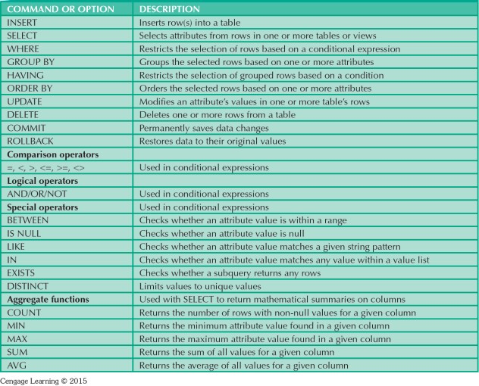
Table 7.2 - SQL Data Manipulation Commands

Slide 10
Data Manipulation Commands
INSERT: Command to insert data into table
Syntax - INSERT INTO tablename VALUES();
Used to add table rows with NULL and NOT NULL attributes
COMMIT: Command to save changes permanently
Syntax - COMMIT [WORK];
Ensures database update integrity

Slide 11
Example 1:Data Manipulation Commands
INSERT INTO tablename
VALUES (value1, value2, ... , valuen)
INSERT INTO vendor
VALUES (21225,‘Bryson, Inc.','Smithson','615','223-3234','TN','Y');
INSERT INTO product
VALUES (‘BRT-345’,‘Titanium drill bit’,‘18-Oct-13’, 75, 10, 4.50, 0.06, NULL);
INSERT INTO product VALUES (345,'Titanium drill bit','2009-10-13', 75, 10, 4.50, 0.06,21225);
INSERT INTO PRODUCT (P_code, P_descript)
VALUES ('BRT-345','Titanium drill bit');
**If only two attributes are required
Notes:
the NULL value is accepted only because the V_CODE attribute is optional.

Slide 12
Data Manipulation Commands
SELECT: Command to list the contents
Syntax - SELECT columnlist FROM tablename;
Use *: List all the contents of a table
UPDATE: Command to modify/change data values
Syntax
UPDATE tablename
SET columnname = expression [, columnname = expression] [WHERE conditionlist];
Update product
set V_code=21225;

Slide 13
Example 2:Data Manipulation Commands
SELECT columnlist FROM tablename
SELECT P_code, P_descript, P_indate, P_qoh, P_min, P_price, P_discount, V_code FROM product;
UPDATE tablename
SET columnname = expression [, columnname = expression]
[WHERE conditionlist ];
UPDATE product
SET P_indate = '18-JAN-2014', P_price = 17.99, P_min = 10
WHERE P_code = '13-Q2/P2';

Slide 14
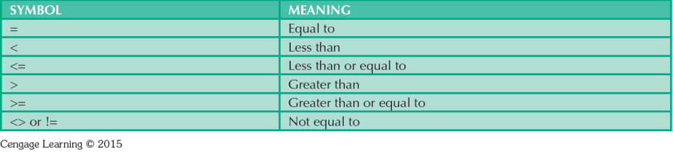
Table 7.6 - Comparison Operators
Notes:
You can use them in the where clause

Slide 15
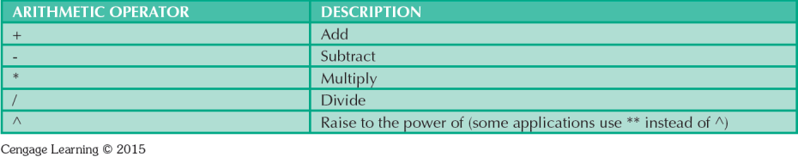
Table 7.7 - The Arithmetic Operators

Slide 16
SQL built-in functions
AVG() - Returns the average value
COUNT() - Returns the number of rows
MAX() - Returns the largest value
MIN() - Returns the smallest value
SUM() - Returns the sum
ROUND() - Rounds a numeric field to the number of decimals specified
FORMAT() - Formats how a field is to be displayed
Example:
SELECT FORMAT(MIN(P_price),2) AS 'min', FORMAT(MAX(P_price),2) AS 'max', FORMAT(AVG(P_price),2) AS 'avg’
FROM product;

Slide 17
The COUNT() Function
Examples:
SELECT COUNT (*) FROM tablename;
SELECT COUNT (attribute name)
FROM tablename;
SELECT COUNT(*) AS NumberOfRows
FROM product;

Slide 18
Special Operators
BETWEEN
Checks whether attribute value is within a range
LIKE
Checks whether attribute value matches given string pattern
EXISTS
Checks if subquery returns any rows
Notes:
The SQL EXISTS condition is used in combination with a subquery and is considered to be met, if the subquery returns at least one row. It can be used in a SELECT, INSERT, UPDATE, or DELETE statement.
http://stackoverflow.com/questions/24929/difference-between-exists-and-in-in-sql
https://www.w3schools.com/sql/sql_between.asp
https://www.w3schools.com/sql/sql_in.asp
https://www.w3schools.com/sql/sql_like.asp
https://www.w3schools.com/sql/sql_null_values.asp
https://www.w3schools.com/sql/sql_exists.asp

Slide 19
Group By Clause
Groups the selected rows based on one or more attributes
Only used when in conjunction with one of the SQL aggregate functions (COUNT, MIN, MAX, AVG, and SUM) in the SELECT statement
See: http://www.w3schools.com/sql/sql_groupby.asp
Notes:
The GROUP BY clause is a SQL command that is used to group rows that have the same values.

Slide 20
Example: Group By Clause
Examples:
Select count(P_price) as numberofrows, P_descriptfrom productgroup by P_descript;
SELECT P_descript, COUNT(*) AS NumberOfRows, FORMAT(MIN(P_price),2) AS 'min', FORMAT(MAX(P_price),2) AS 'max', FORMAT(AVG(P_price),2) AS 'avg’
FROM product
group by P_descript;

